Slide 1
Comidas Tradicionales
Por Lobo

Slide 2
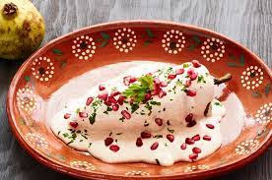
What is the name of the dish?
Chiles en Nogada

Slide 3
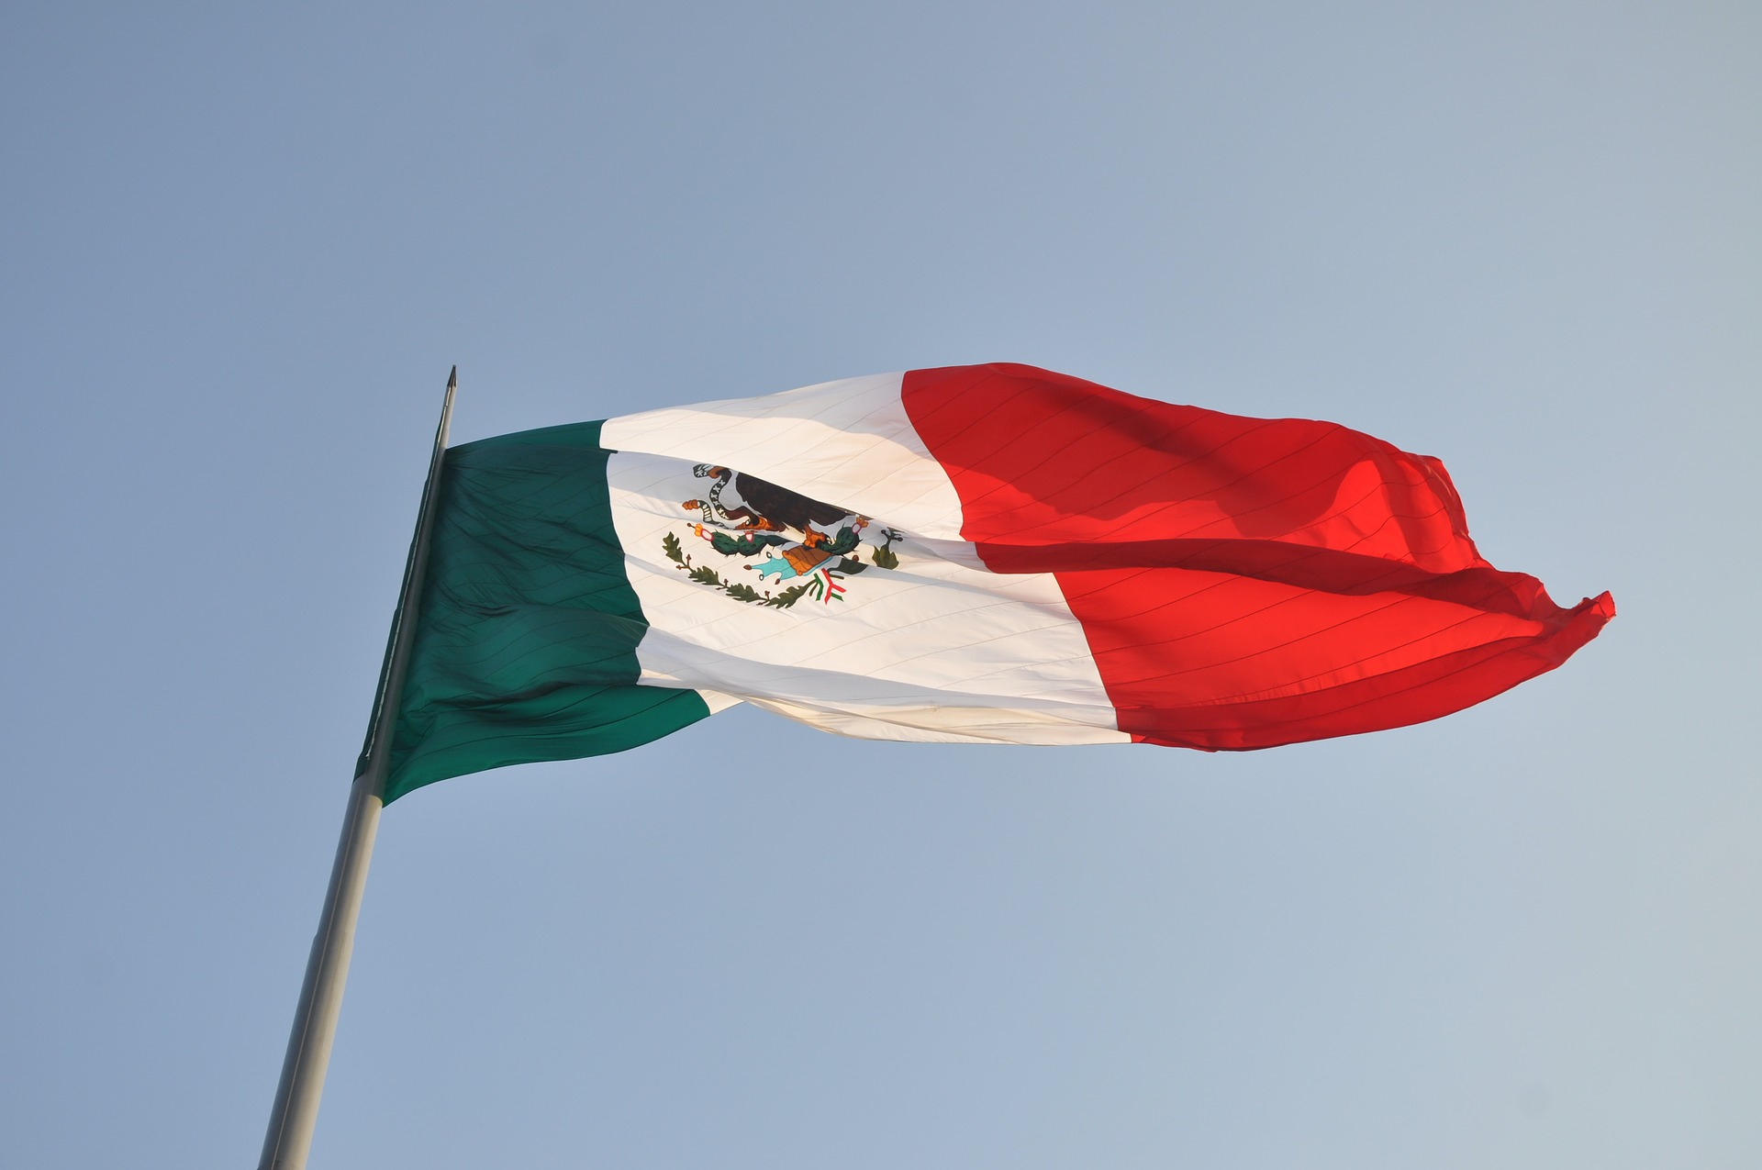
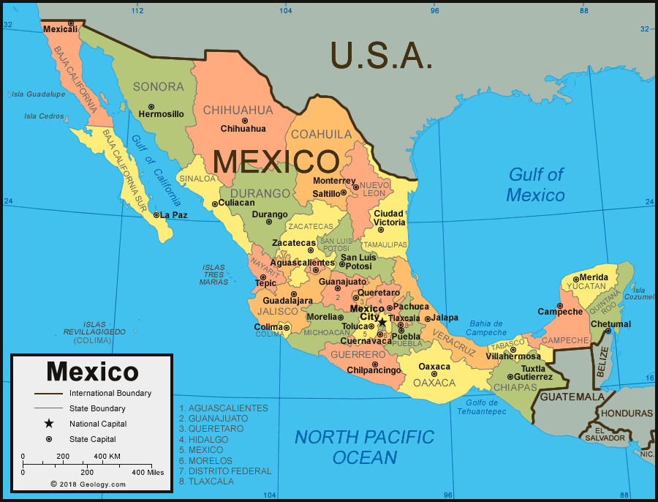
Where is Chiles en Nogada from?
Mexico

Slide 4
Ingredients to dish
Ingredients
Chili's
Nogada (Walnut based creamy sauce)
Shredded meat
Dried fruits
Pomegranate seeds
Milk
Turkey
Sour Cream
Sugar
Cinamon
Oils
Tomatoes
In detail description
The food consists of poblano chiles with a mix usually containing meat that is shredded, dried fruits and different kinds of spices, with a walnut based creamy sauce that is called nogada, and pomegranate seeds. Which gives it the three colors of the Mexican flag: green from the chili, white from the nut sauce and red from the pomegranate.

Slide 5
The Origins of Chiles en Nogada
This dish was invented in Puebla, Mexico 1821. It was made to present General Agustin de Iturbide of the Mexican Army. He was involved in a battle to gain control of Mexico City and win the Mexican War of Independence. He had just signed the Treaty of Cordoba which gave Mexico its independence and when he was on his way back to Mexico City. He was passing through Puebla and the residents presented this meal to him. And now the dish is eaten by many people and used for Mexican Independence Day to honor the general and the battle.

Slide 6
Would I try this dish and recommend it to other people?
In my opinion I would recommend it to people because it looks very good with sauce and the pepper and it is spicy, so that would have a nice texture and I would try it because it looks very good for a meal in general. The meal is a pepper that is spicy and if you love spicy foods and peppers than it is good to try otherwise don’t or do.

Slide 7
Work Cited
https://www.topuniversities.com/blog/14-amazing-mexican-food-drinks-you-should-try
www.wordreference.com
https://condesarestaurant.com/chiles-en-nogada/#:~:text=Chiles%20en%20Nogada%20is%20a,offering%20at%20many%20Mexican%20restaurants.
https://everythingplayadelcarmen.com/chiles-en-nogada-mexican-history-in-every-bite/#:~:text=A%20Little%20History%20of%20Chiles,the%20Mexican%20War%20of%20Independence.
Google Image Search
https://mexicanfoodjournal.com/chiles-en-nogada/
https://geology.com/world/mexico-satellite-image.shtml
https://www.simplyrecipes.com/recipes/chiles_en_nogada_chilies_in_walnut_sauce/

